Slide 1
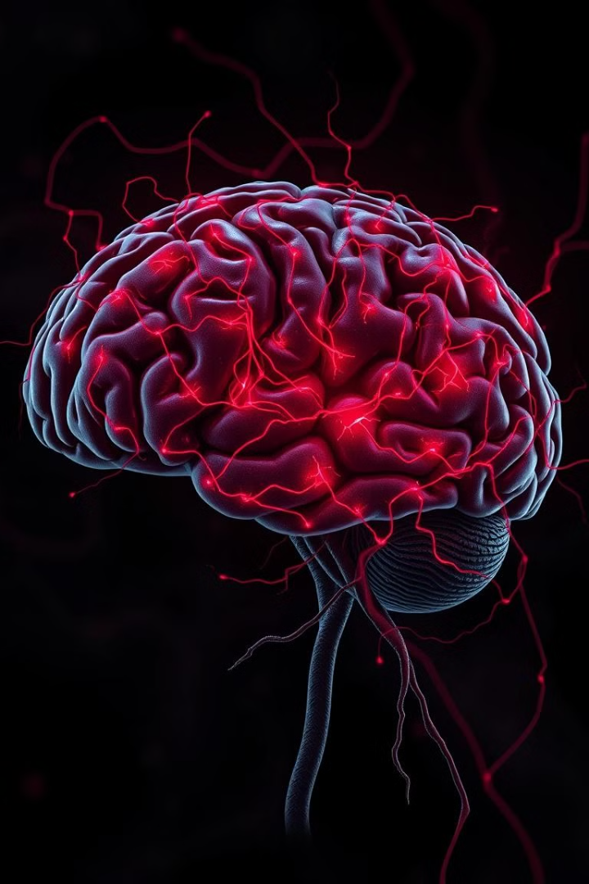

Machine Learning and Neural Networks: An Introduction
Dive into the world of machine learning and neural networks, exploring their fundamentals, applications, and future potential. This presentation offers a comprehensive introduction to these rapidly evolving fields.
by Jayesh Sharmila

Slide 2
What are Neural Networks?
Inspired by the Brain
Interconnected Nodes
Neural networks are a type of machine learning that mimic the structure and function of the human brain.
They consist of interconnected nodes or neurons that process and transmit information, similar to biological neurons.

Slide 3



Inspiration from the Human Brain
1
Learning by Example
2
Adaptive Behavior
3
Pattern Recognition

Slide 4
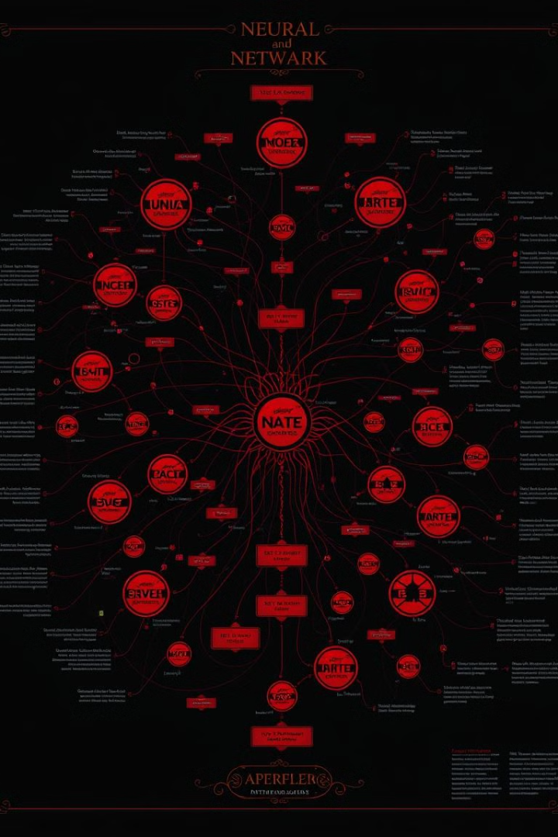
Key Components of Neural Networks
1
Neurons
2
Connections
Basic processing units that receive, process, and transmit information.
Links between neurons that represent the strength of their relationships.
3
Weights
4
Activation Functions
Numerical values associated with connections that influence the flow of information.
Mathematical functions that determine the output of a neuron based on its input.

Slide 5
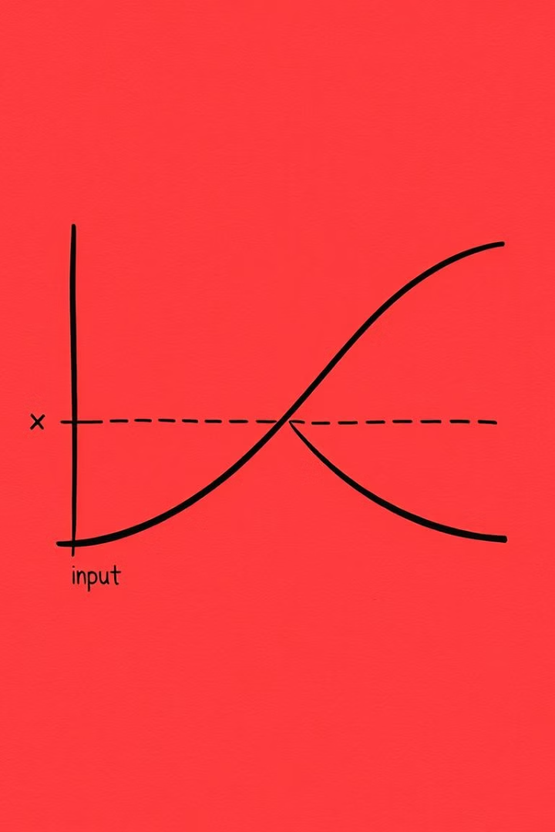



Activation Functions and their Role
Sigmoid
ReLU
Squashes input values between 0 and 1, ideal for binary classification tasks.
Introduces non-linearity, allowing for efficient training and faster convergence.
Softmax
Normalizes outputs to a probability distribution, suitable for multi-class classification.

Slide 6
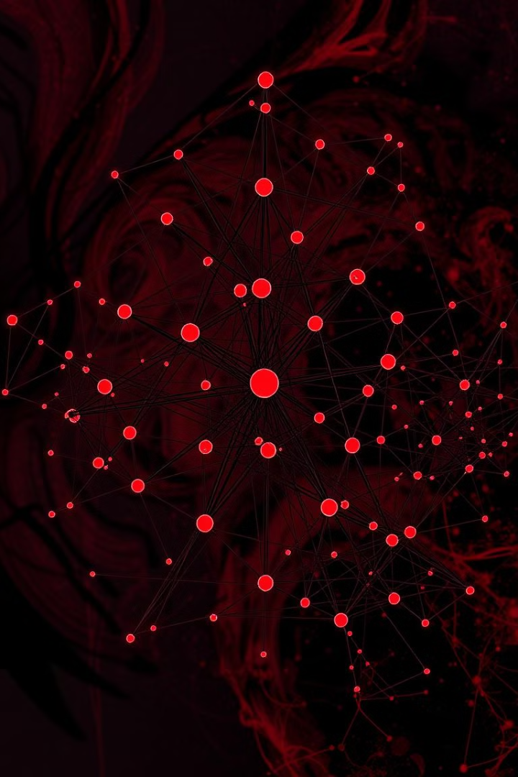

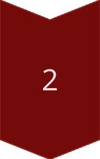
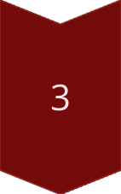
Feedforward Neural Networks
Input Layer
Receives raw data and passes it to subsequent layers.
Hidden Layers
Perform intermediate computations and extract features from the data.
Output Layer
Produces the final predictions or classifications based on the network's learning.

Slide 7
Backpropagation and Training Neural Networks
Error Calculation
1
Quantifies the difference between the network's output and the desired target.
Weight Adjustment
2
Modifies the weights of connections to minimize the error and improve accuracy.
Iterative Process
3
Repeatedly feeds data and adjusts weights until the network reaches optimal performance.

Slide 8
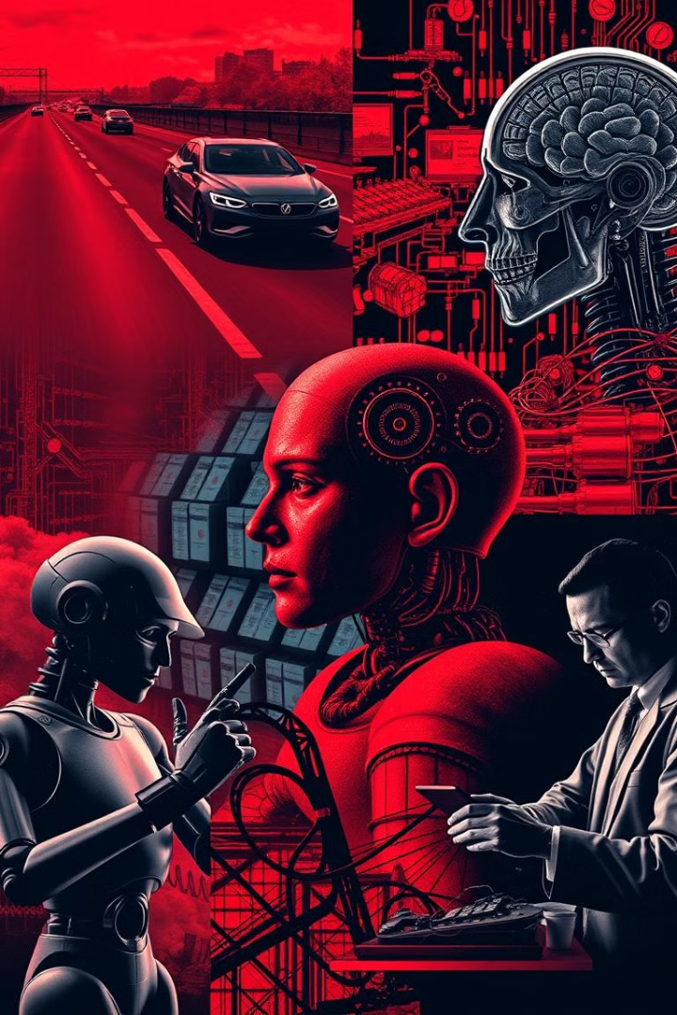
Applications of Neural Networks
Image Recognition
Natural Language Processing
Identify objects, scenes, and faces in images with high accuracy.
Understand, interpret, and generate human language, powering chatbots and language translation.
Predictive Modeling
Forecast future events, trends, and outcomes based on historical data.

Slide 9
Machine Learning vs. Deep Learning
Machine Learning
Deep Learning
Broad field encompassing various algorithms that learn from data.
Subfield of machine learning focusing on complex neural networks with multiple layers.

Slide 10

The Future of Neural Networks and Machine Learning
1
2
Personalized Medicine
Autonomous Vehicles
3
Smart Cities

